Slide 1
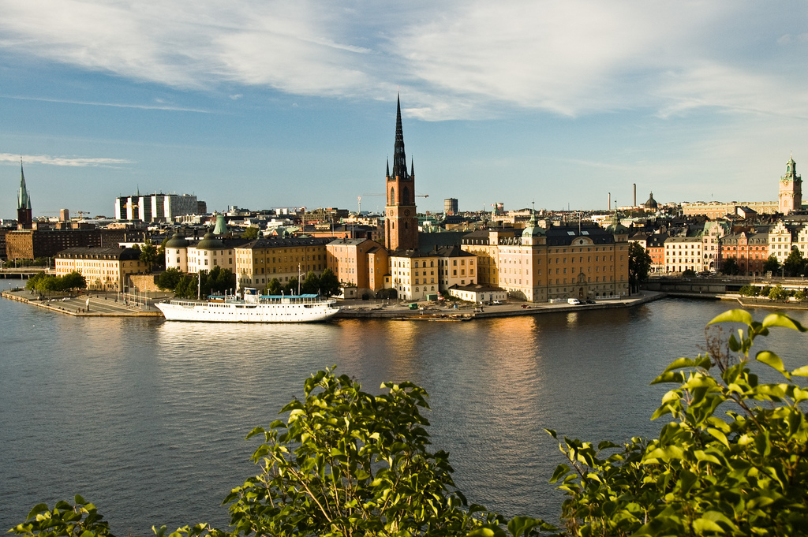
Welcome to Stockholm

Slide 2
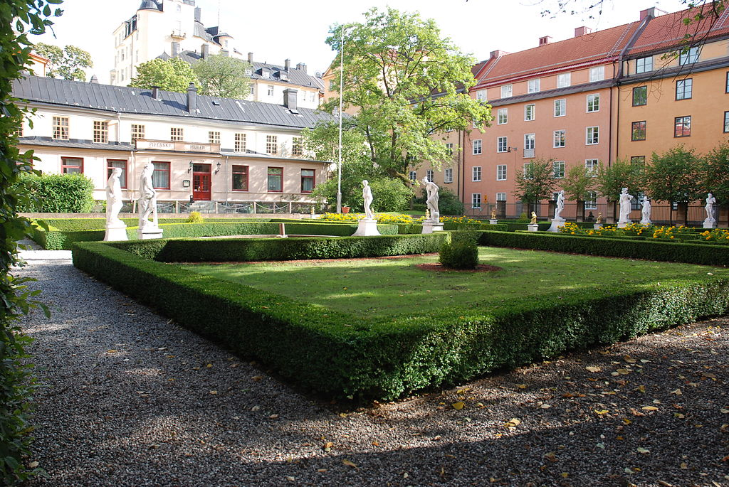
Piperska muren
1695 Summer house for earl Carl Piper

Slide 3


Slide 4
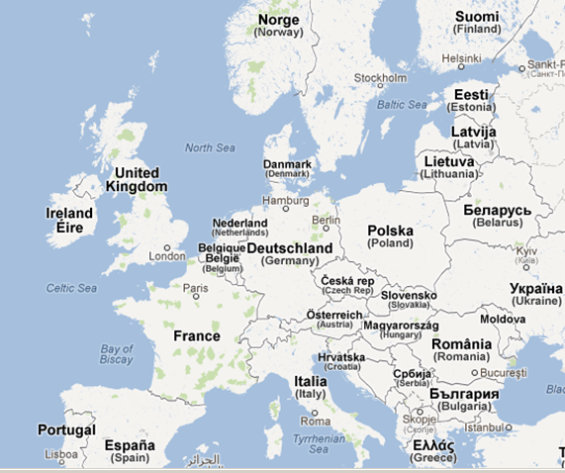
European Green Capitals
Stockholm 2010
Copenhagen
2014
Bristol
2015
Hamburg
2011
Nantes
2013
Vitoria Gasteiz
2012

Slide 5
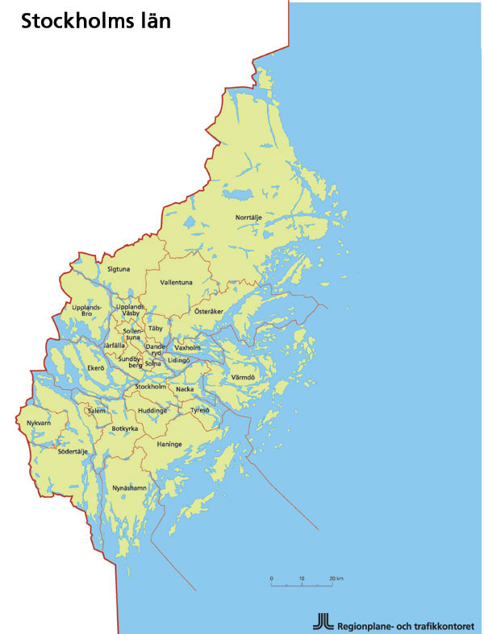
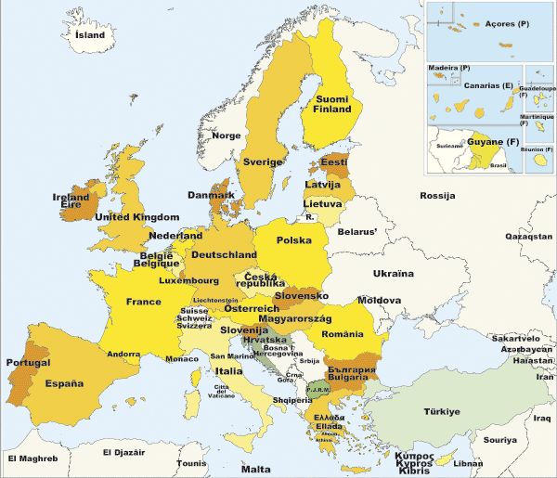
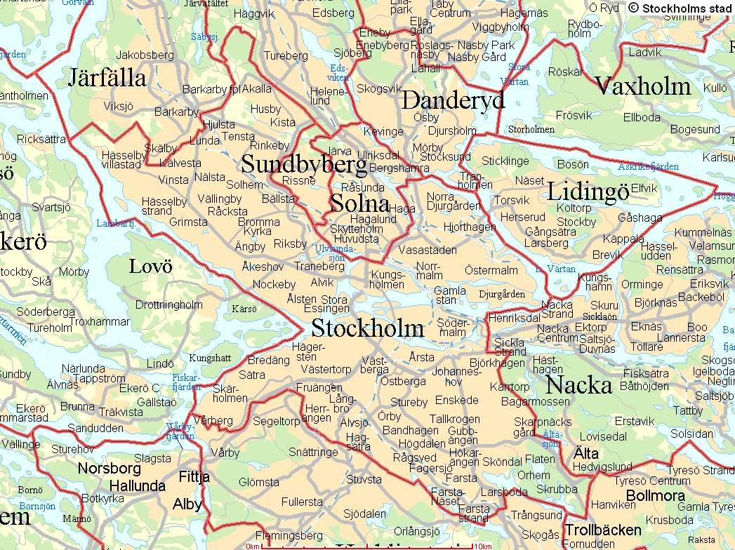
Sweden 9,5 Milj
410 335 km² 22 inv/ km²
County of Stockholm 2,1Milj 6519 km² 299 inv/ km²
City of Stockholm
900 000 188 km² 4300 inv/km²
Söderort 68 km² 3000 inv/km²
Västerort 83 km² 3600 inv/ km²
Innerstan 36 km² 8500 inv/ km²
Notes:
First some basic facts
Sweden i long country in the north of Europe. We have 9 million inhabitants
The greater Stockholm has 2miljon inhabitants and the City of Stockholm has 800 000 inhabitants.

Slide 6
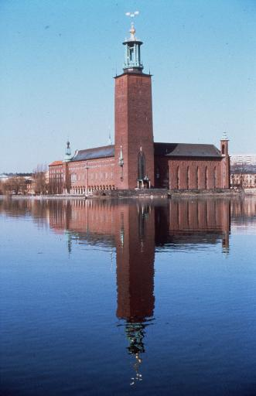
Vision 2030 combining growth with sustainable development
250 000 more citizens
Denser city
140 000 new dwellings
Urban mentality
Fossil free 2050
Urban structure and green belts
Integrated sustainable solutions
Public Awareness

Slide 7
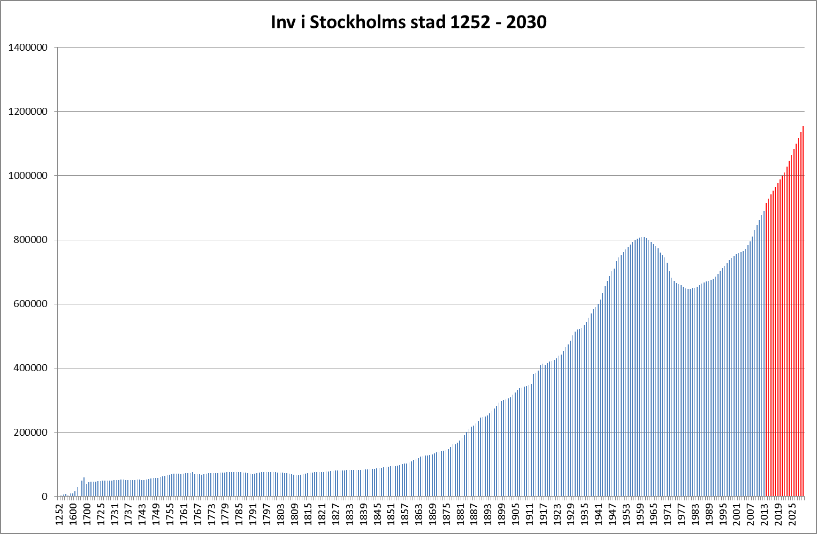
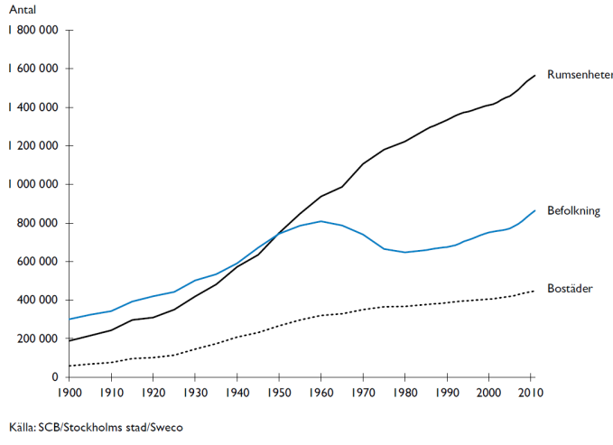
The latest forecast shows an even higher growth

Slide 8
Goals and achievements
Fossil fuel free
Real Development
Goals

Slide 9

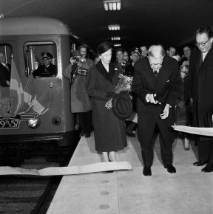
Long-term perspective.
Again!

Slide 10
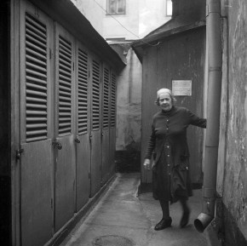
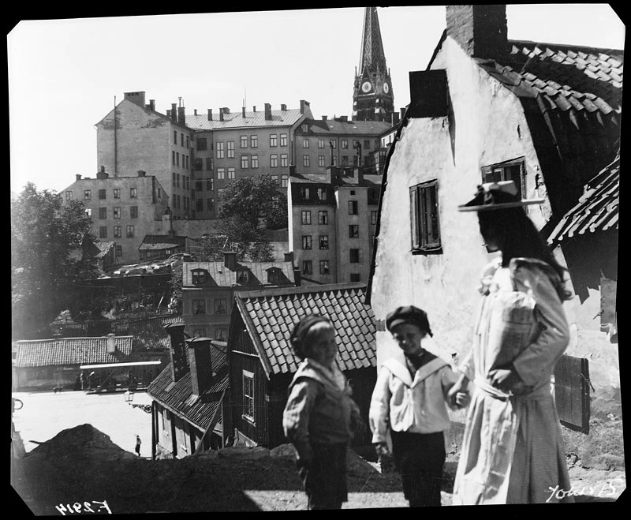
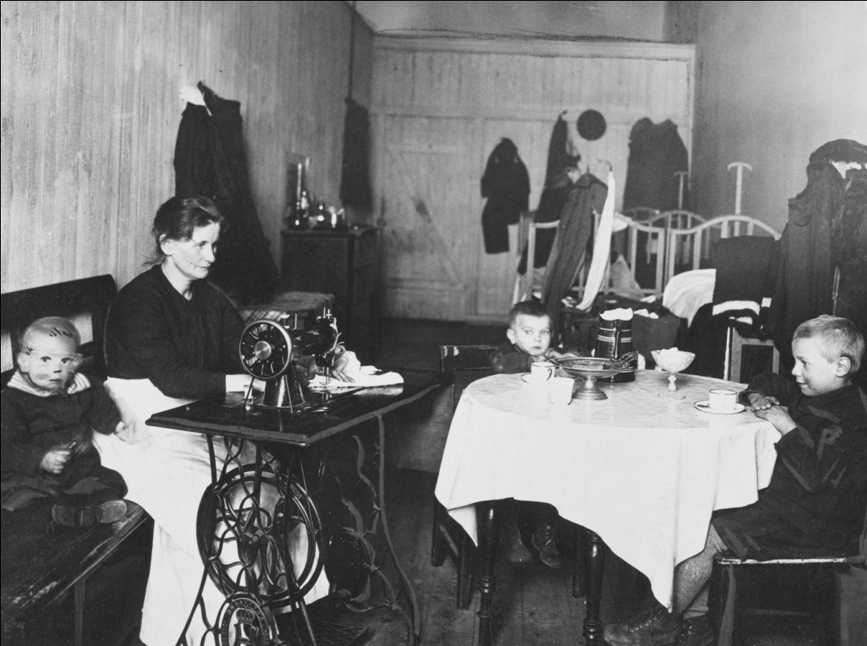
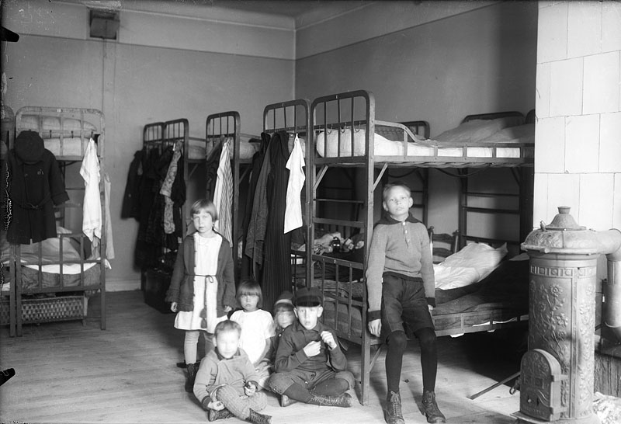

Slide 11
The Hammarby Waterfront project
Size 180 ha
10 400 new flats
200.000 m2 new offices, services
Construction time 1995–2017
Sustainable development
Renewable energy use
Integrated transport and land use
Eco cycle model

Slide 12
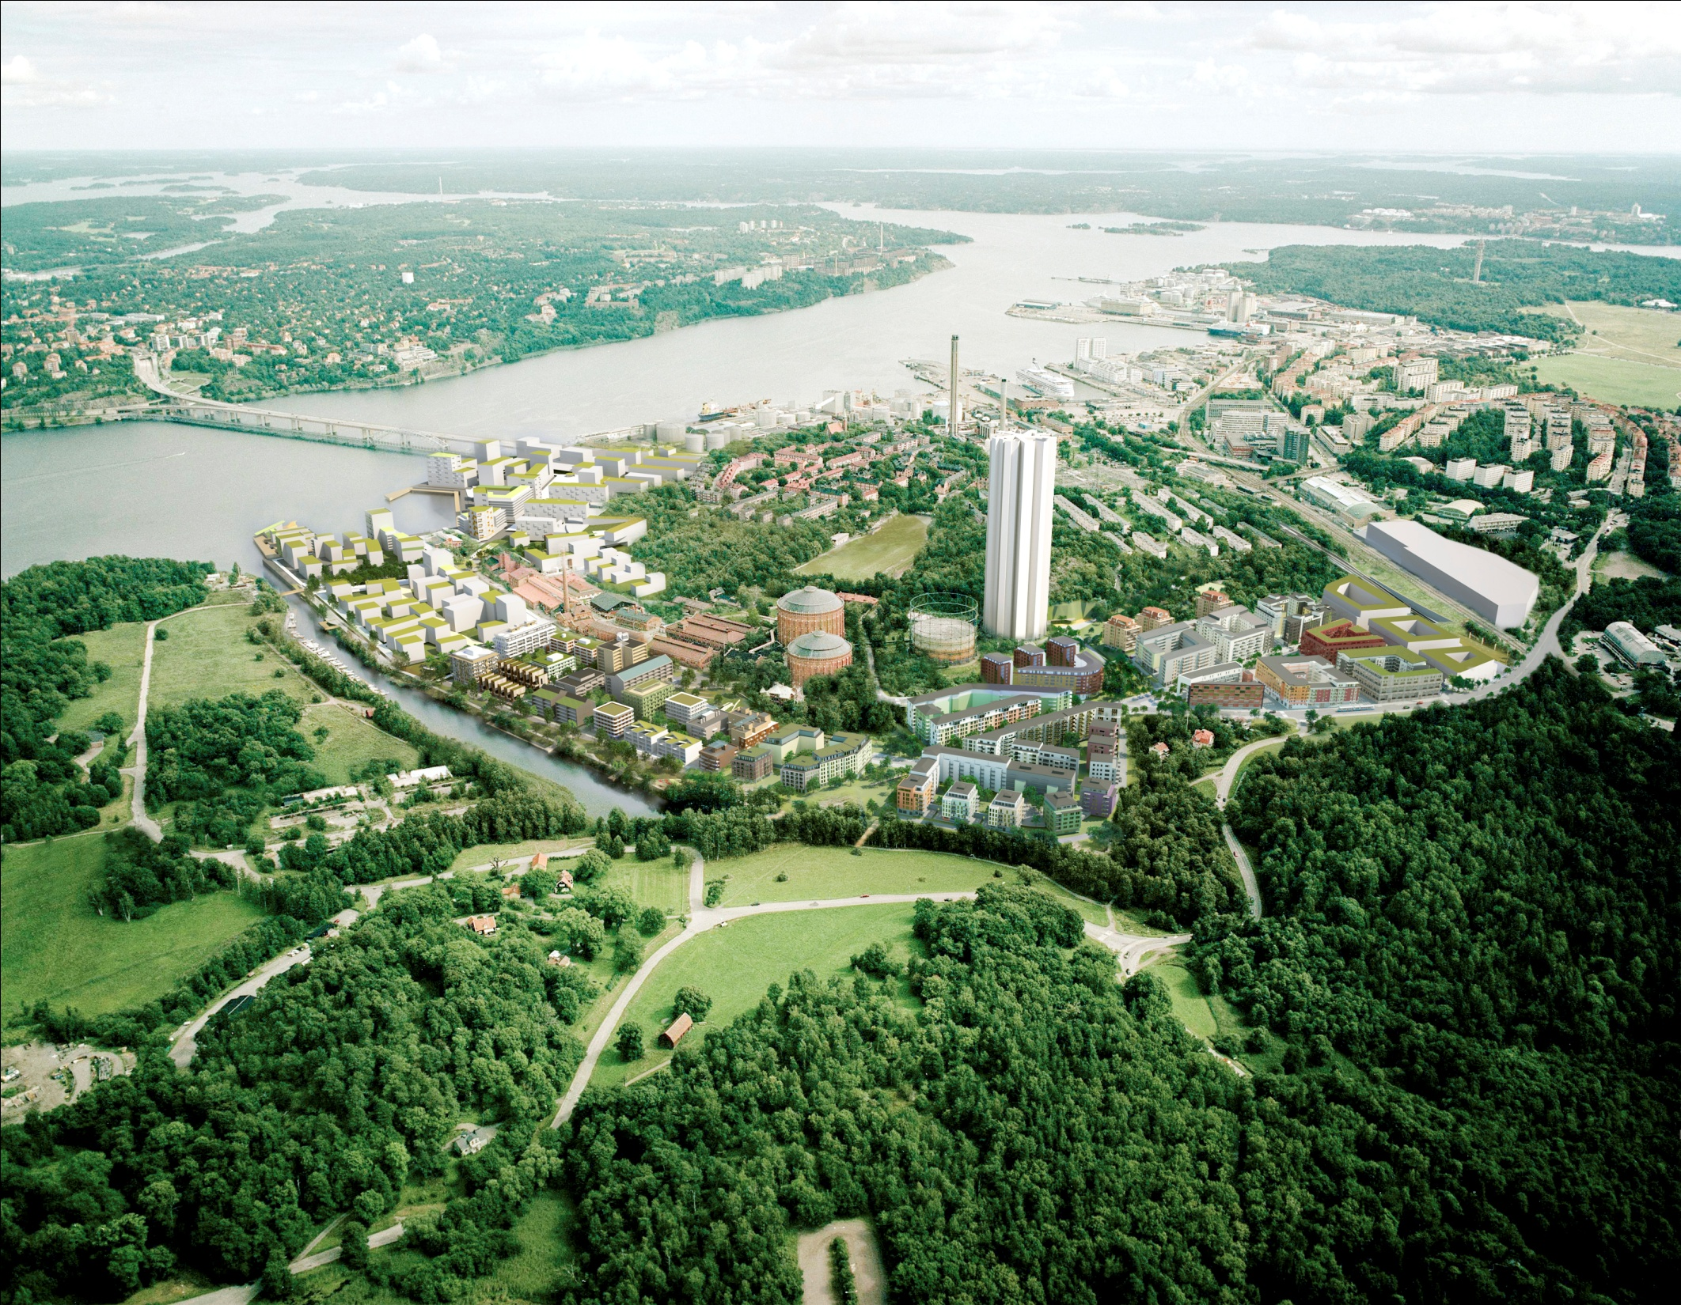

The Royal Seaport

Slide 13
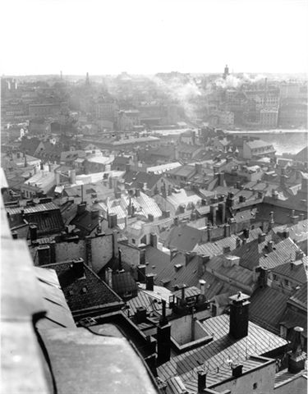
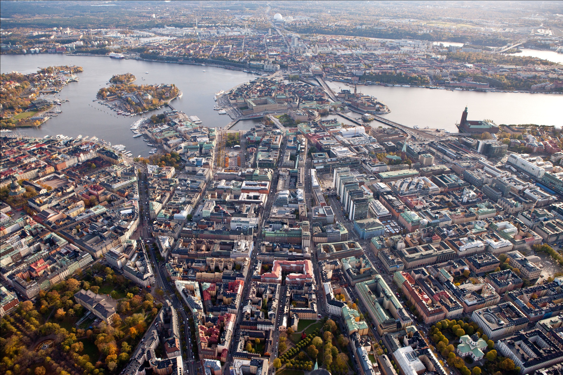
Stockholm has 100 times better air quality today compared with 1965

Slide 14
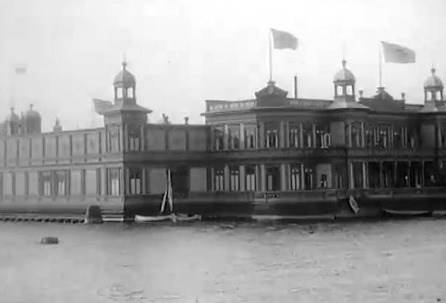
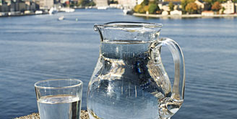
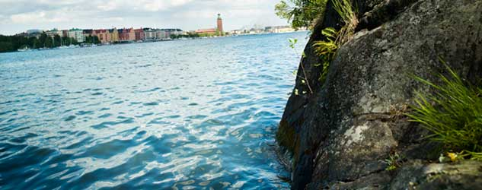

Slide 15

City of Stockholm Chemicals Management Strategy
For a non-toxic Stockholm 2030

Slide 16

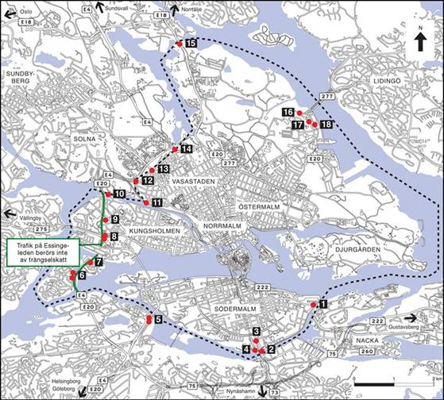
Congestion charges
20 % decrease in traffic
10 – 14 % decrease of emissions
2 – 10 % better air quality
Less human exposure
From huge opposition to broad majority in favor

Slide 17
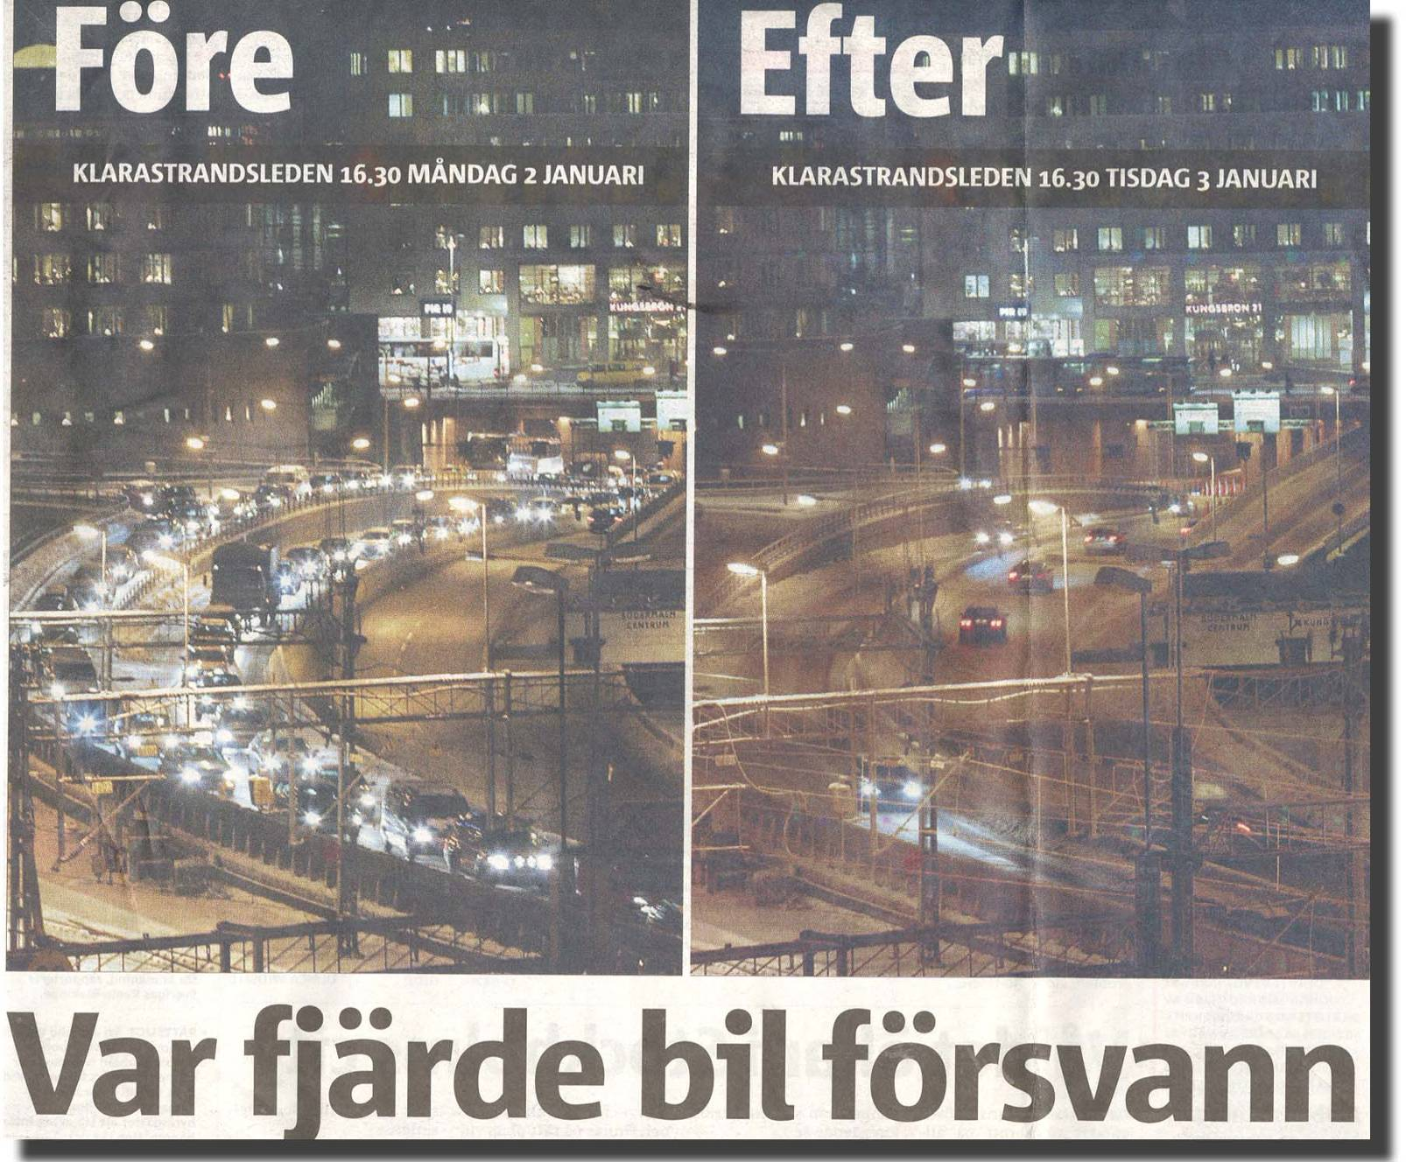

Slide 19
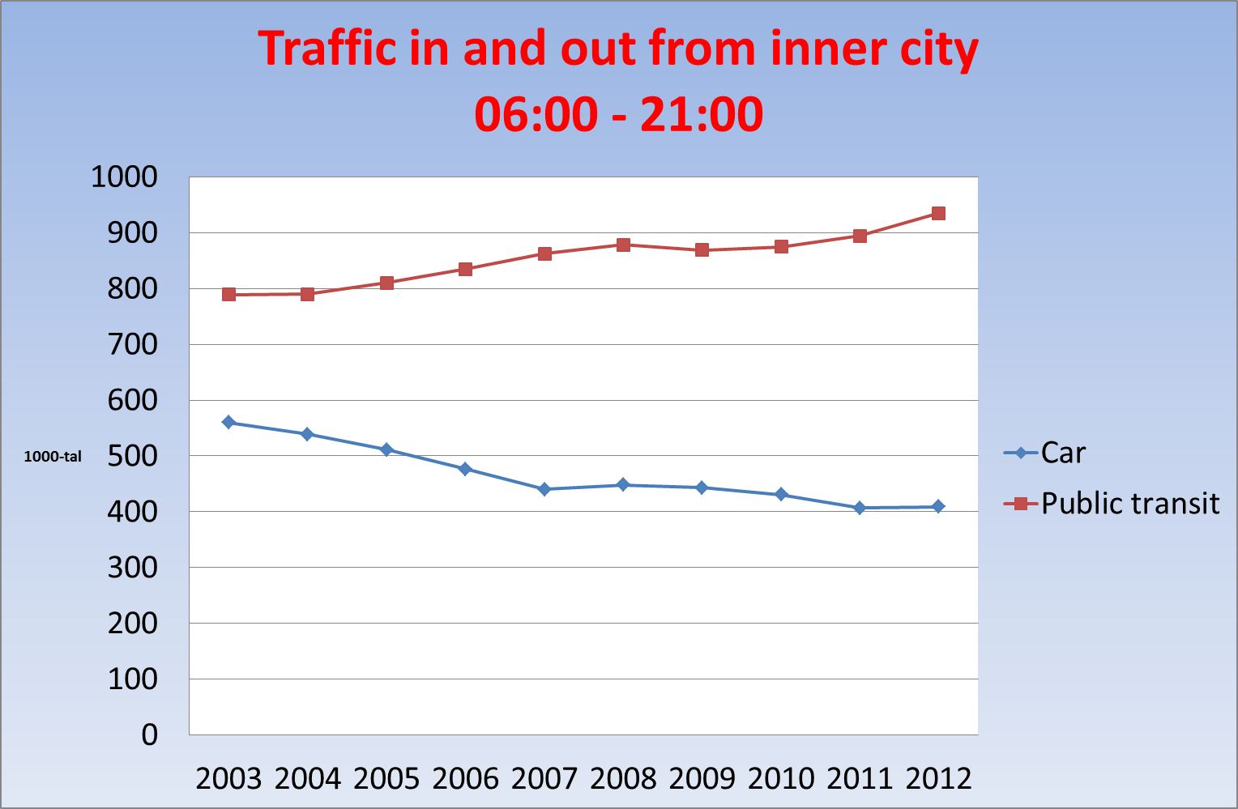

Slide 20
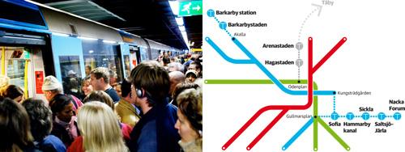
New metro lines financed by rised congestion tax

Slide 21
How did you go to work September 2013

Slide 22
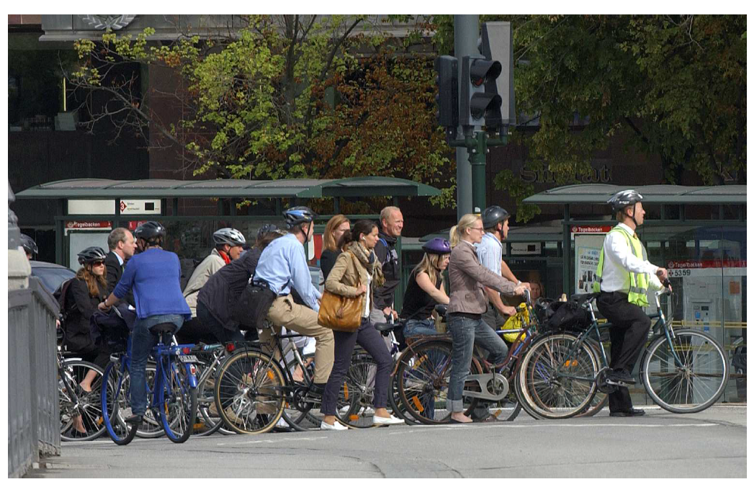
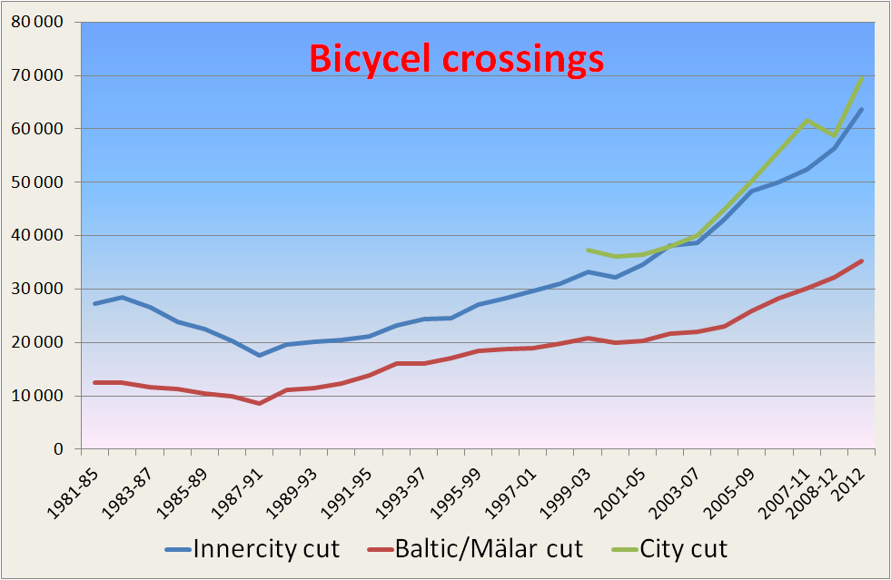

Slide 23
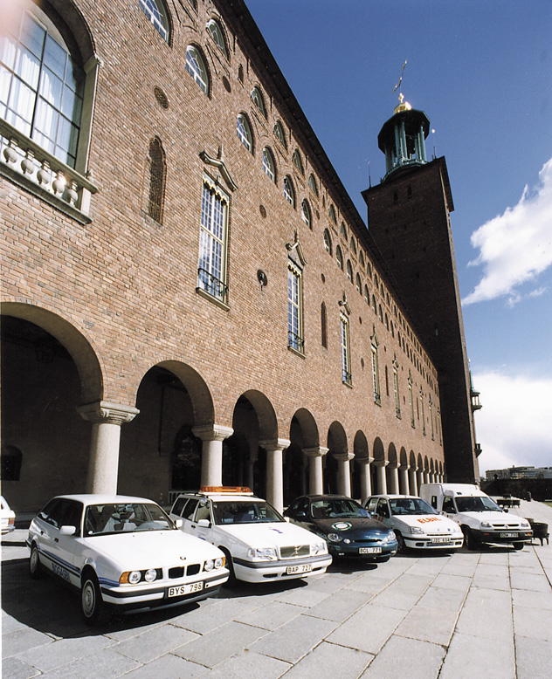
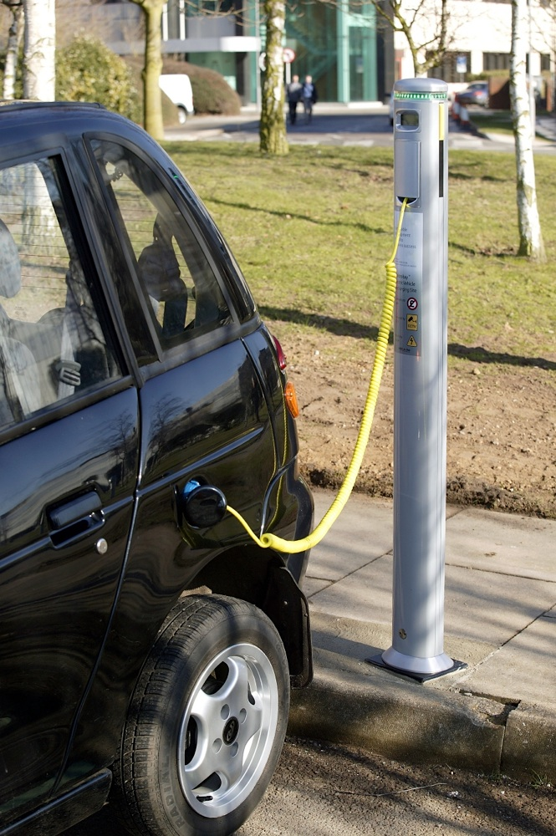
Electrical vehicles, plug in hybrids, nnew infrastructure

Slide 24
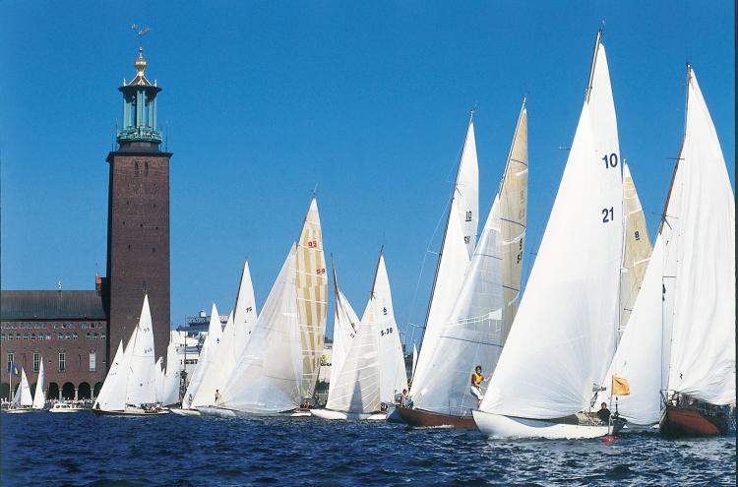
Once again.
Welcome to Stockholm!
www..stockholm.se/international
gunnar.soderholm@stockholm.se

