Slide 1
Electric vehicles in norway and oslo
Marianne Mølmen
Agency for Urban Environment, City of Oslo

Slide 2
An introduction to how…

Slide 3
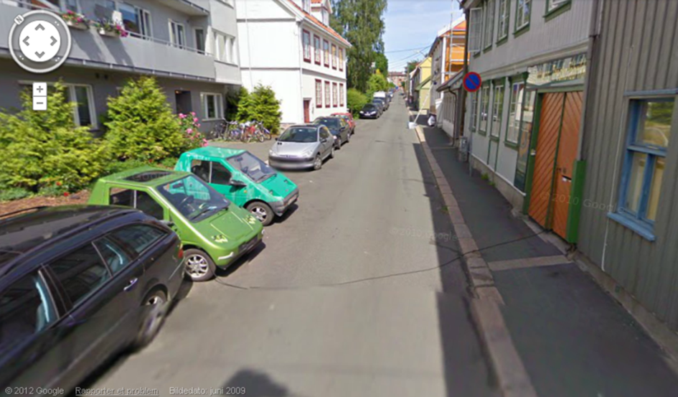

Oslo Went from this:

Slide 4
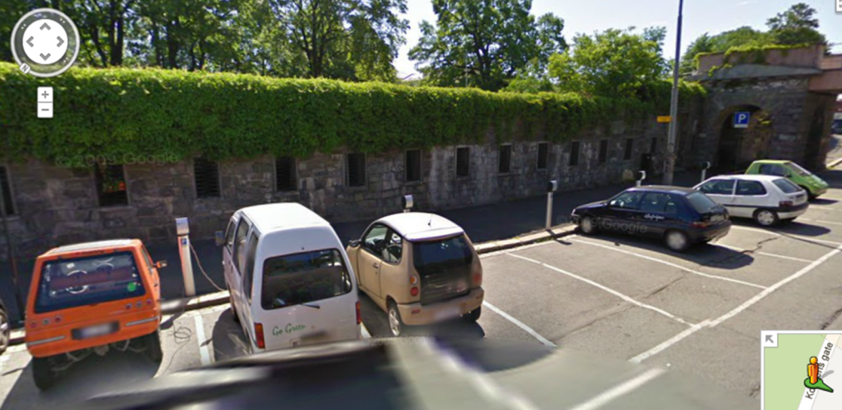
to this

Slide 5
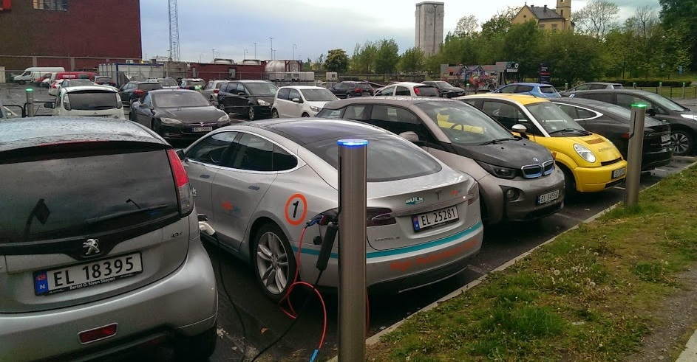
and FINALLY this.
36 charging points at one location in downtown Oslo

Slide 6


WHY ELECTRIC VEHICLES in a country with cold winters and mountains?

Slide 7

Renewable energy
99 % of all electricity produced in Norway comes from hydro.
Electricity in 2011:
Produced: 125 000 GWh
Consumed: 121 800 GWh
Early EV industry since 1990s (Pivco/Think, Kewet/Buddy)

Slide 8
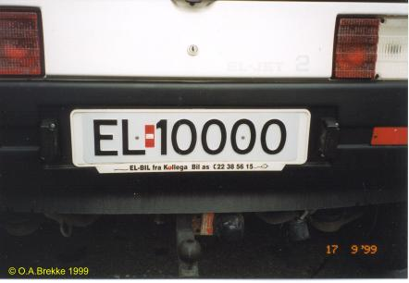
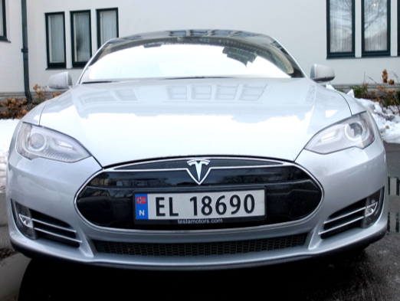
Early ev industry – early adaption
«EL» licence plates since 1992.
Makes it easy to identify the vehicle as electric.
Hydrogen vehicles «HY». Natural gas vehicles «GA».

Slide 9
EARLY INCENTIVES – VEHICLE TAXES
High taxes on fossil fuel cars:
  25% Value Added Tax (VAT)
  «One-time registration fee»
  calculated on the basis of:
  - the weight of the vehicle
  - the emissions (CO2 and NOX)
  - the engine size (ccm) or effect (hp)
  Electric vehicles have NO TAXES OR FEES
Price example in Euro:
Sweden:
Nissan Leaf 27 100
Nissan X-Trail 30 100
Norway:
Nissan Leaf 27 700
Nissan X-Trail 49 500

Slide 10

An extreme example:
Chevrolet Camaro
Price in Norway (high taxes): 174 500 EUR
Price in Sweden (low/no taxes): 47 100 EUR

Slide 11
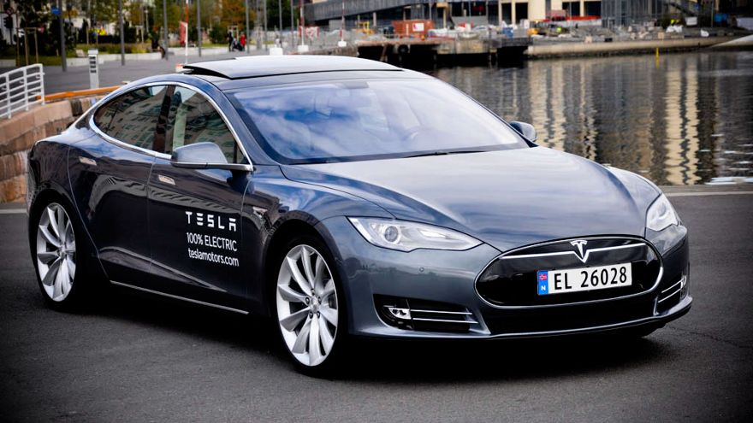
AN EXTREme electric example: tesla model s
Price in Norway (no taxes): 63 000 EUR
Price in Sweden (low taxes): 80 000 EUR

Slide 12
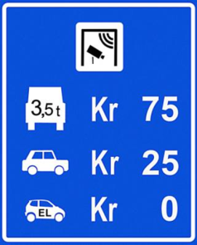


INCENTIVES – DAILY USE SAVINGS
Free access on toll roads (1997)
In Oslo € 3,5 – 5,
National roads and tunnels up to € 20.
Free parking (1999)
€ 2 – 5 per hour
Access to use bus and taxi lanes (2003)
10 min -1 hour per day
Local and national EV infrastructure program (2008)
4000 normal + 80 fast charging points
Free transport on ferries (2009)
€ 12 – 24 each way

Slide 13
European sale of electric vehicles
EV market share in Norway 2014: February 12%, March 21% , April 12%,

Slide 14

Government schemes
Incentives since late 1990s
Government guarantee that incentives will last until 2017 or 50 000 EVs
Transnova government fund -
Provide funding for sustainable mobility projects.
Transnova funded projects:
Normal charging stations
Fast charging stations
NOBIL charging station database
Hydrogen buses in Oslo
Biofuel projects
EV taxi projects
Zero Emission Rally
Land power supply for ships

Slide 15
City of oslo - 400 public on-street charging points
Incentives for purchase and use were already in place, but public infrastructure and places for city residents to charge their EV was missing.
400 public on-street charging points was decided in the City Council together with funding. € 500 000 every year 2008-2011.
Decision was part of a “10-point plan to reduce emissions” in the city.

Slide 16
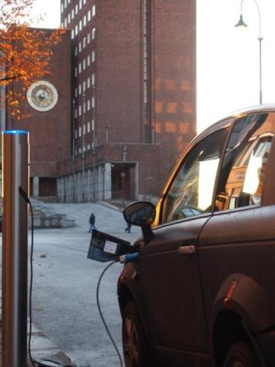
Establishing charging stations
Several methods:
Place charging points where EVs are parked
Place charging points after suggestions from EV or potential EV drivers
Place charging points in highly visible places (f.ex in front of City Hall, at stadiums, near movie theatres)
«Fill in the gaps» in the charging station map
In front of Oslo City Hall

Slide 17
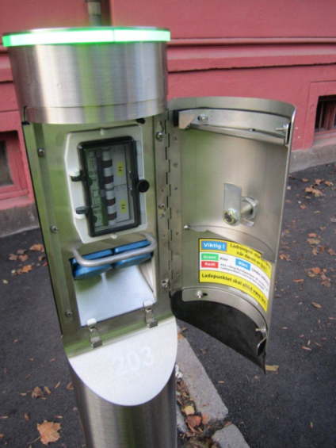
charging points 2009-2012
Old EVs (PSA, Think, Kewet) to consider
230 V
2 x Schuko (european domestic) socket
2 x 16A circuit breaker
2 x hook for heavy EVSE box
Physical key access
No communication or intelligence in the charging stations – made them inexpensive
Average cost in electricity per point per day:
€ 1

Slide 18
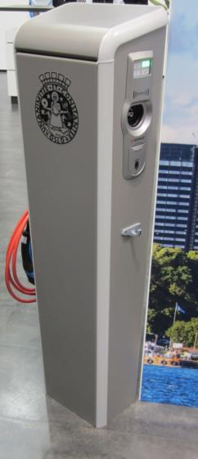
Charging points – eu tender 2013
Winner: Charging station produced
by Mennekes (Germany)
230 Volt
2 x Type 2 sockets
2 x Schuko socket
2 x 16A circuit breaker
Hook on each side to hang UMC-box
RFID and SMS access control
Communicates via GPRS
400 charging points with this model will be established in 2013-2014

Slide 19
Charging spaces OCCUPANCY
Average occupancy 2009:
Day: 37%
Night: 6%
Average occupancy 2012:
Day: 70%
Night: 39%
Up to 110% at the most popular locations during daytime.
Focus on increasing charging spaces in areas with high night-time occupancy (residents needing to charge).

Slide 20
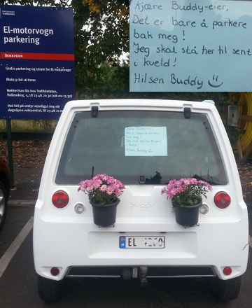
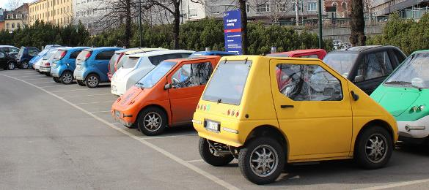
occupancy
«Buddy-parking» lead to occupancy higher than 100%.
Efficient use of space!

Slide 21
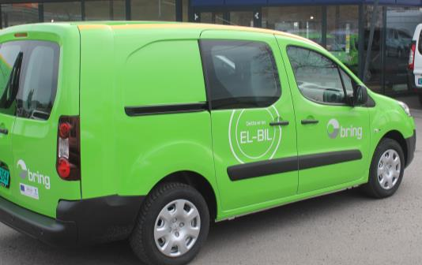


Cooperation – city of oslo
Close cooperation with the Norwegian EV Association
EU project EVUE -
Electric Vehicles in Urban Europe
Network project to exhange strategies and experience on EVs.
EU project FREVUE –
Project to use EVs for goods and parcel delivery in the city center. Collect data on cold weather performance of EVs.
BRING express delivery company use four electric vehicles in the Oslo city center

Slide 22
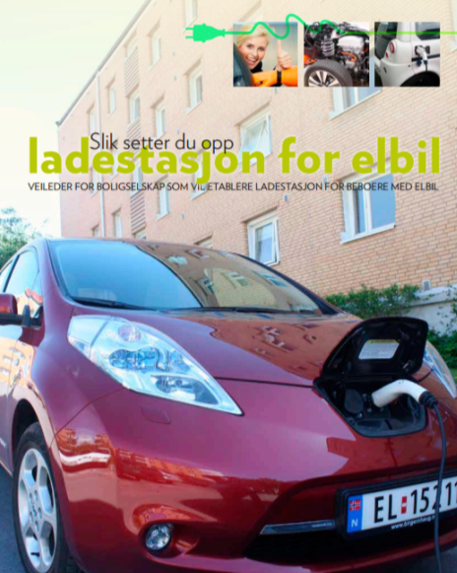
Subsidies from the Climate- and Environment fund
Private companies, apartment complexes, shopping centers etc. can apply for subsidies to establish charging points.
Up to € 1 200 per charging point established and maximum 60% of the total cost can be subsidized.
The Agency for Urban Environment administer the applications.
422 charging points established since 2008.

Slide 23
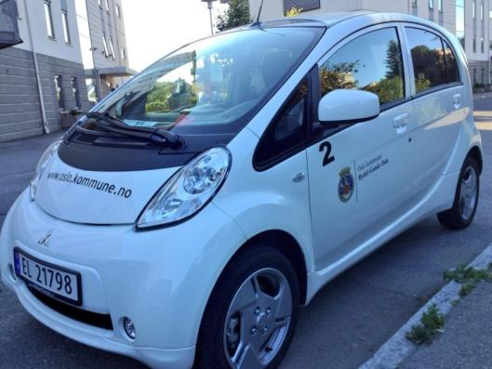
Electric vehicles for municipal fleet
Almost 1000 vehicles in the municipal fleet will be electric vehicles within 2015.
New fleet vehicle contract with LeasePlan from January 2013:
Small passenger car:
Mitsubishi I-MiEV
Medium passenger car: Nissan Leaf
Small cargo van: Peugeot Partner EV
EV used for home care services for elderly people in Bydel Gamle Oslo

Slide 24

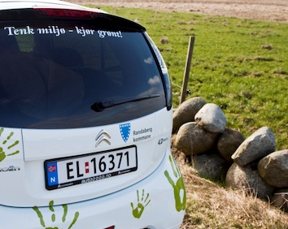
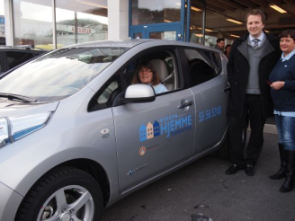
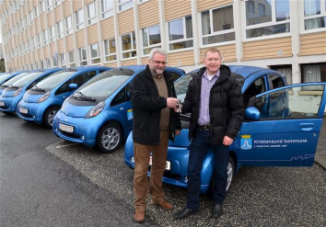
Municipal fleet - oslo
Per 19.5.2014:
164 Misubishi I-MiEV
61 Nissan Leaf
27 Peugeot Partner EV
Total per 19.5.2014:
252 electric vehicles!
Other municipalities are also going electric:
- Kristiansund kommune
- Bergen kommune
- Randaberg kommune
- Trondheim kommune

Slide 25


Municipal fleet – oslo EXperiences
- Users are positive and very few negative feedbacks.
- Charging problems was thought to be an issue, few problems incurred.
- A few issues related to limited range, but only related to a few agencies/entities.
Main challenge: securing funding for purchase and convincing to spend extra for smarter charging (type 2)

Slide 26
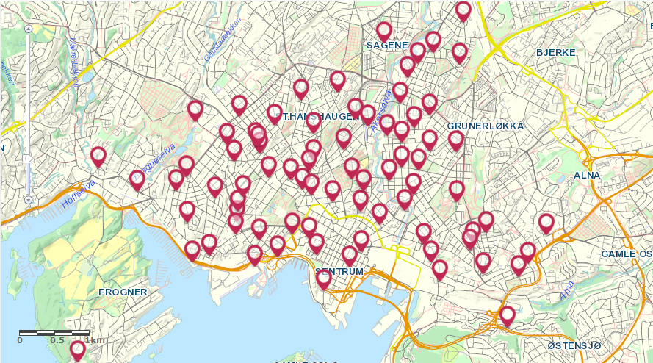
Thank you
marianne.molmen@bym.oslo.kommune.no

