Slide 1
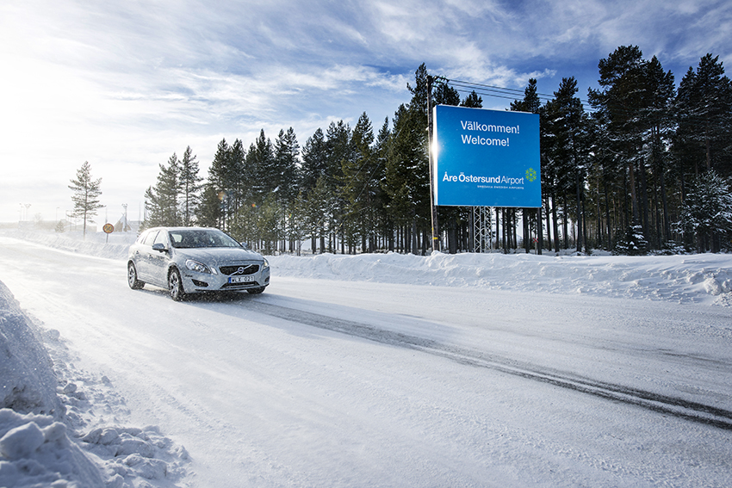
Notes:
Welome to mid Sweden and mid Norway, the Green Highway region…

Slide 2
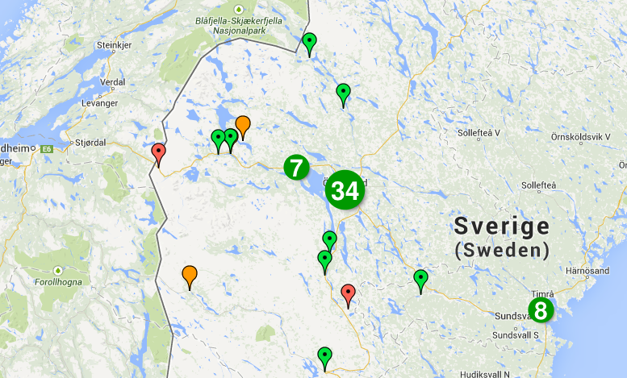
Notes:
Assignment from the Swedish Energy Agency to build a large scale charging infrastructure as a national example…

Slide 3
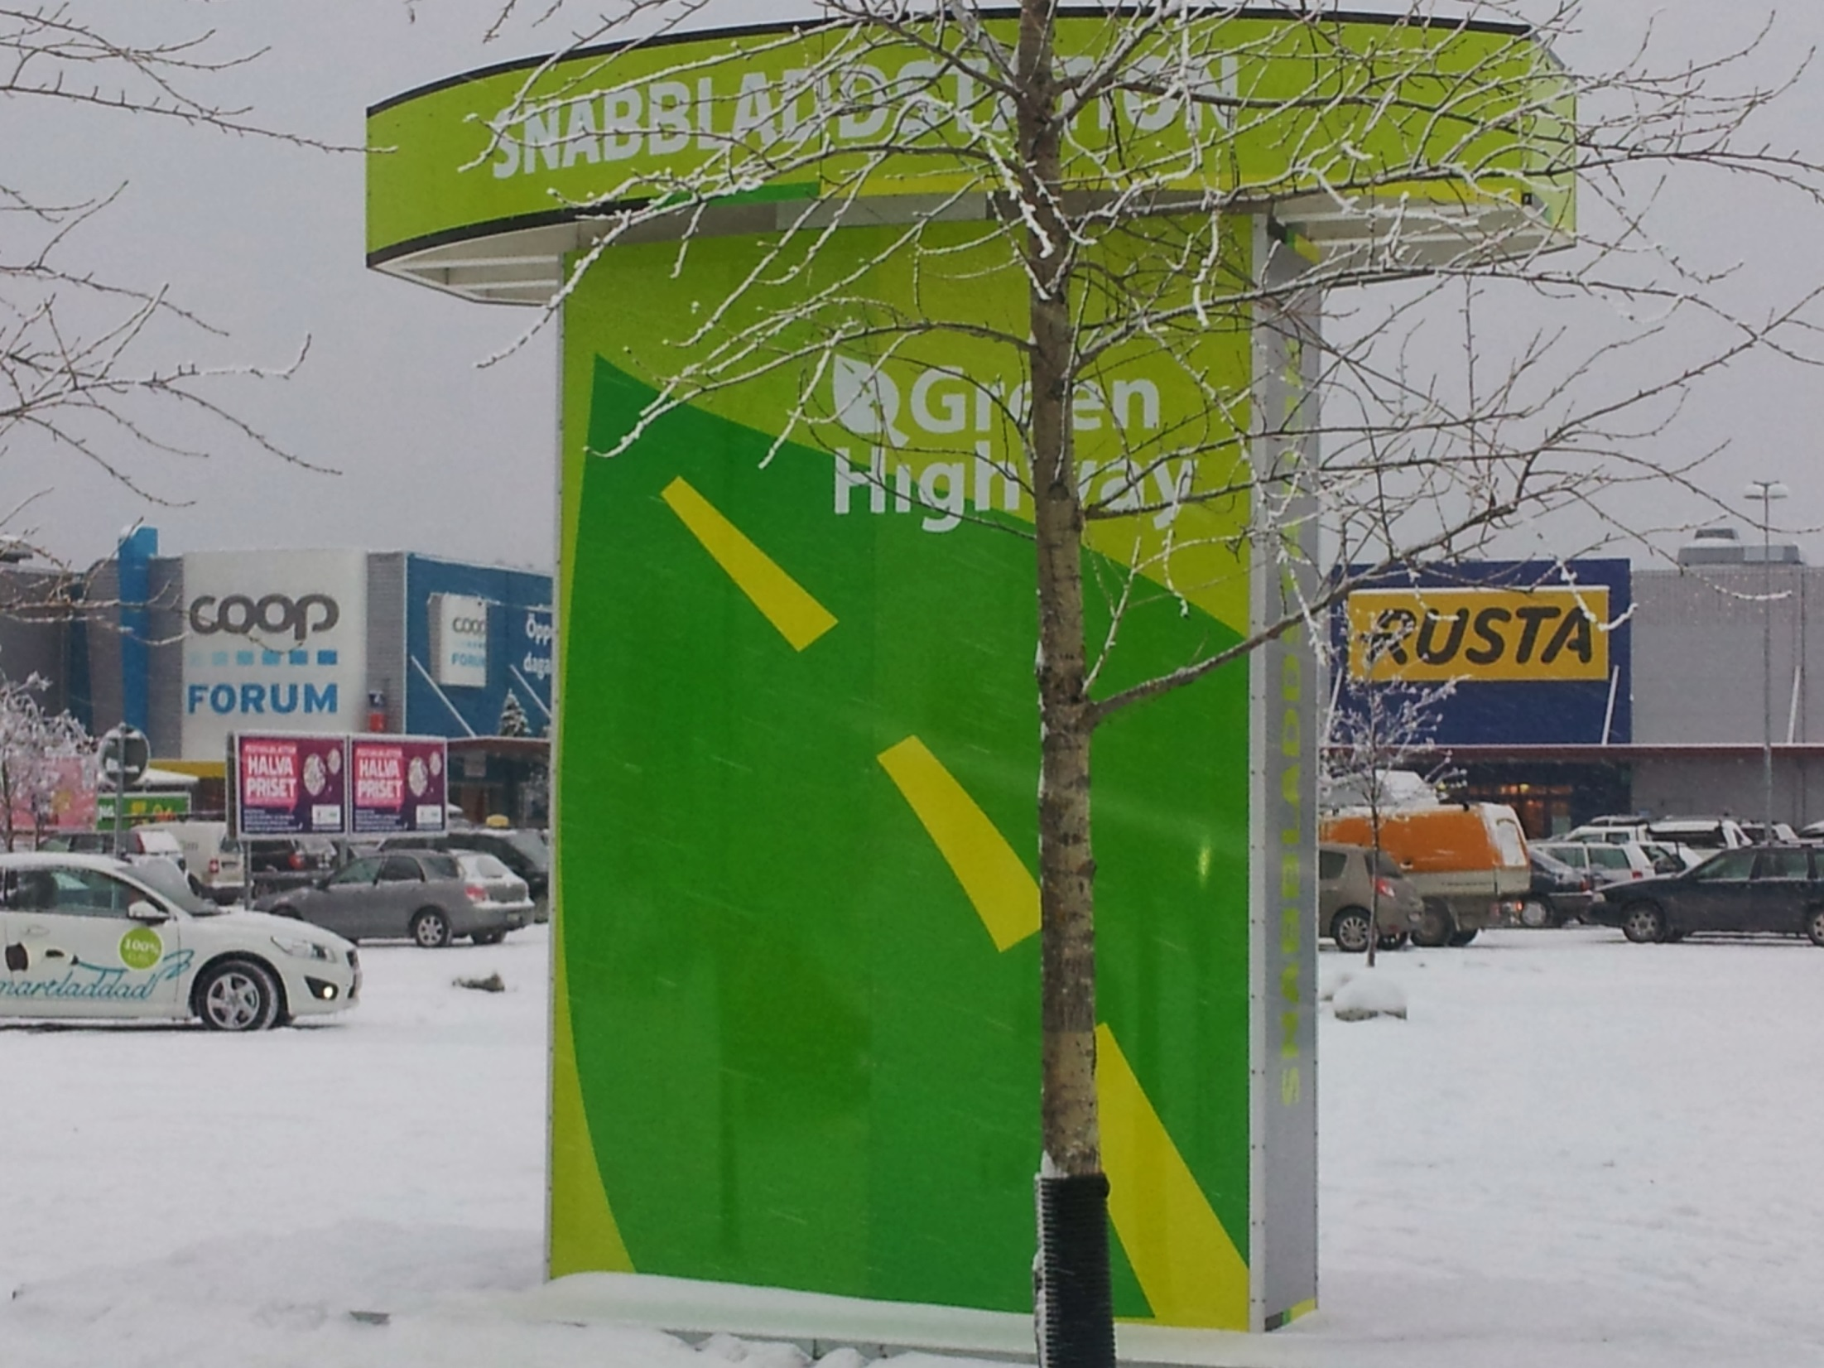
Notes:
Setting a new brand… in this case the Green Highway project between Trondheim – Östersund - Sundsvall

Slide 4
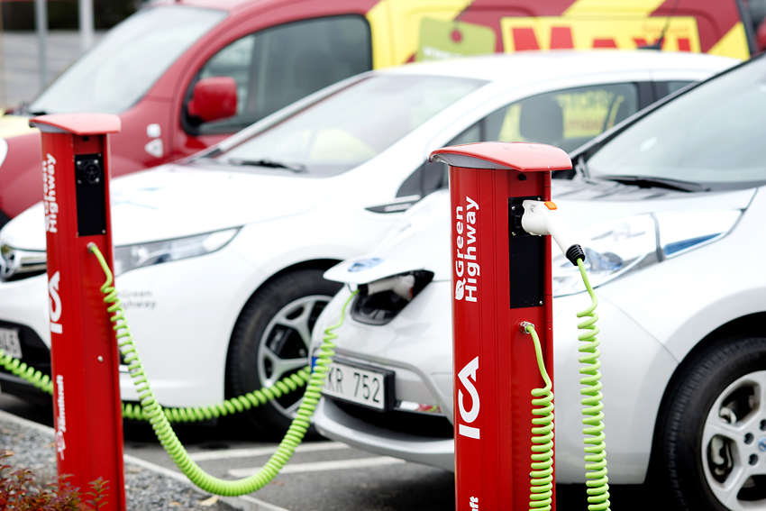
Tack!
Notes:
Let investors take part… such as airports, hotels, cities, malls, resorts, utilities and so on…

Slide 5
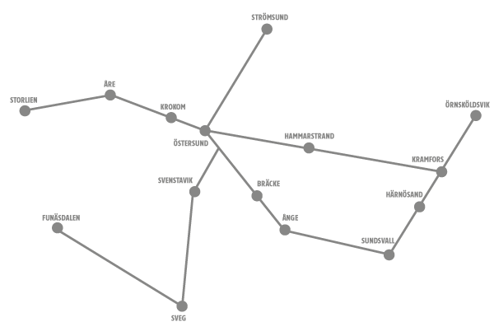
www.jamtkraft.se/viladdar
Notes:
Find out more…www.jamtkraft.se/viladdar

Slide 6
ACEA, EURELECTRIC och CLEPA
Mode 3 = AC with Type 2, 3,7 kW to 22 kW
Mode 4 = DC with CCS/Combo from 22 kW
Case C = Fixed cables from 3,7 kW
Notes:
Postionpaper from may 2012… strongly recommends fixed cables from 3.7 kW

Slide 7
Swedenergy, Bil Sweden, charger manufactures agrees to use Mode 3 Type 2
May 21th 2013
Notes:
See to it that you know which way the development goes…

Slide 8
Directive of the EU on the deployment of alternative fuels infrastructure.
“Alternate Current (AC) normal power recharging points for electric vehicles shall be equipped at least with socket outlets or vehicle connectors of Type 2”
Direct Current (DC) high power recharging points for electric vehicles shall be equipped at least with connectors of Type "Combo 2"
Notes:
S.k. trialog pågår då Kommissionen, parlamentet och ministerrådet förhandlar med varandra om ett slutligt förslag.
Antalet publika laddstationer har föreslagits vara 14 000 st, 7000 st eller 1 laddstation för 10 elbilar.

Slide 9
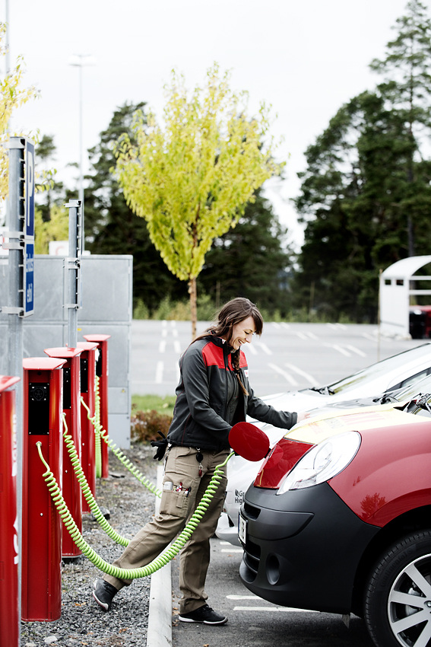
Smart laddning
Notes:
Customer friendly and safe… and no outlets… Wallboxes and rapid chargers, the missing link is smart chargers! And it’s not expensive…

Slide 10
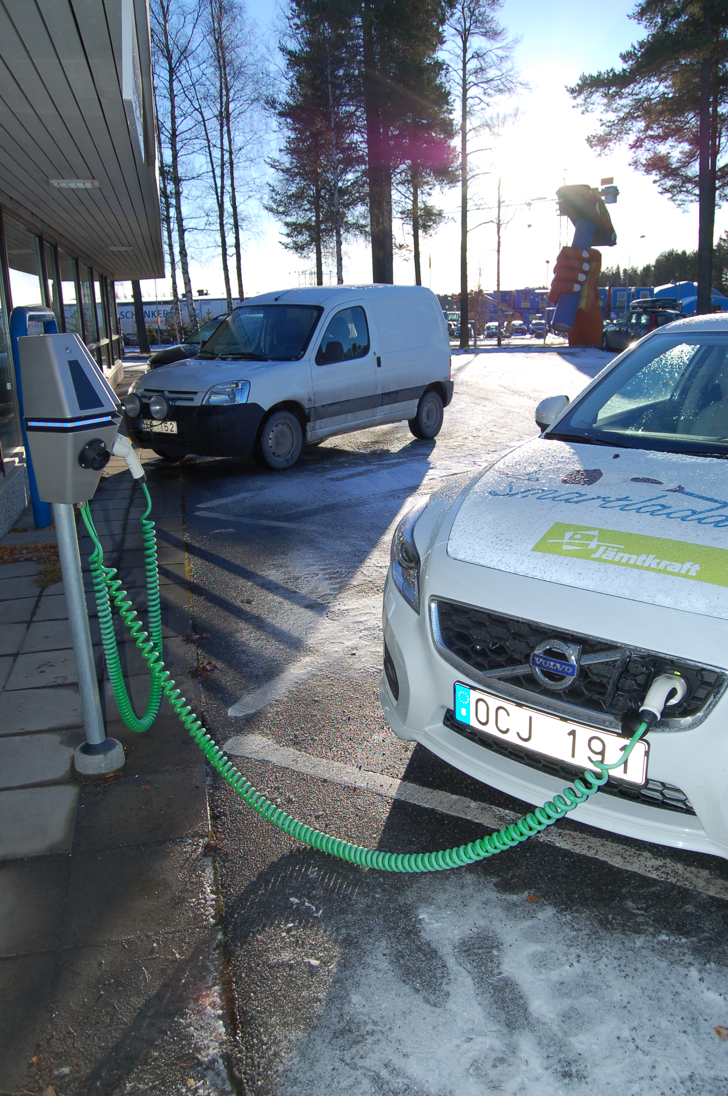
Smart charging

Slide 11
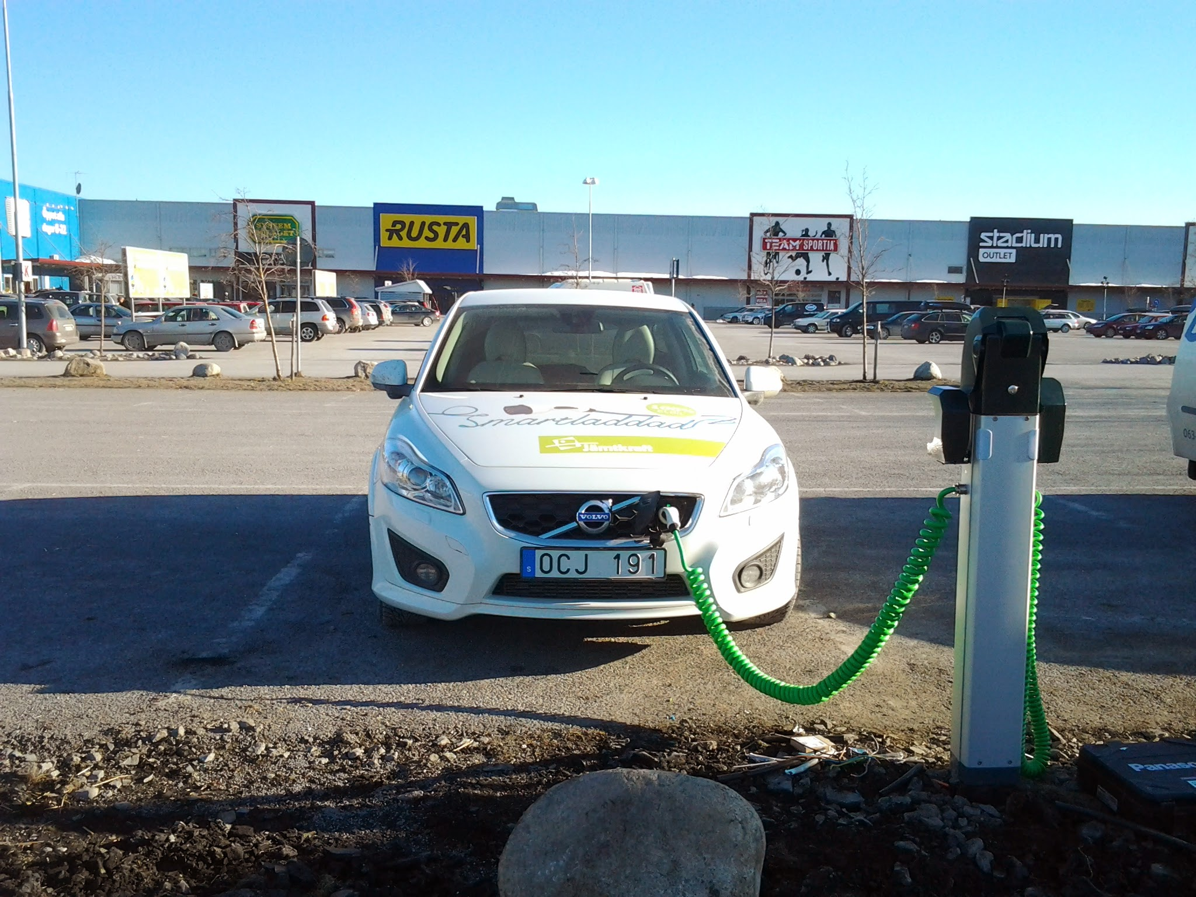
Smart charging
Notes:
Standard AC Mode 3 fixed cables ”case C”. Communication between the car, the charger, the user, the grid and the ”cloud”…

Slide 12
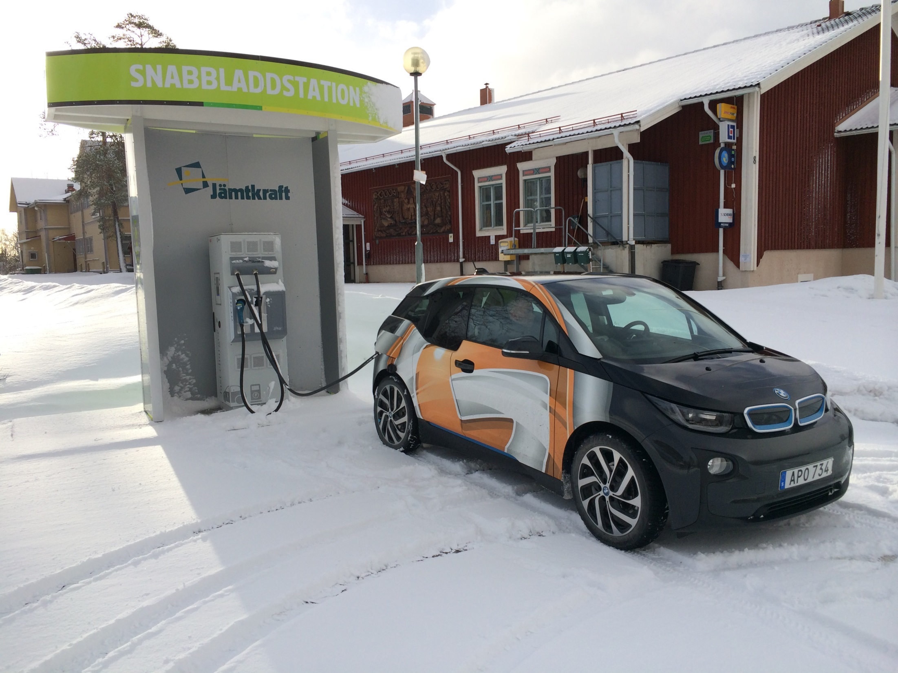
Fast charging
Notes:
Standard DC Mode 4. Communication between the car, the charger, the user, the grid and the ”cloud”…

Slide 13
What happens during 2014-15
Business models for charging and operating
Pay for the right to charge not the power
Flat rate subscription and ”Pay & Go”
Norway takes the lead (Charge & Drive, EV-Power)
Large scale investments i charging infrastructure
EU-standards in all extension of the charging infrastructure

Slide 14
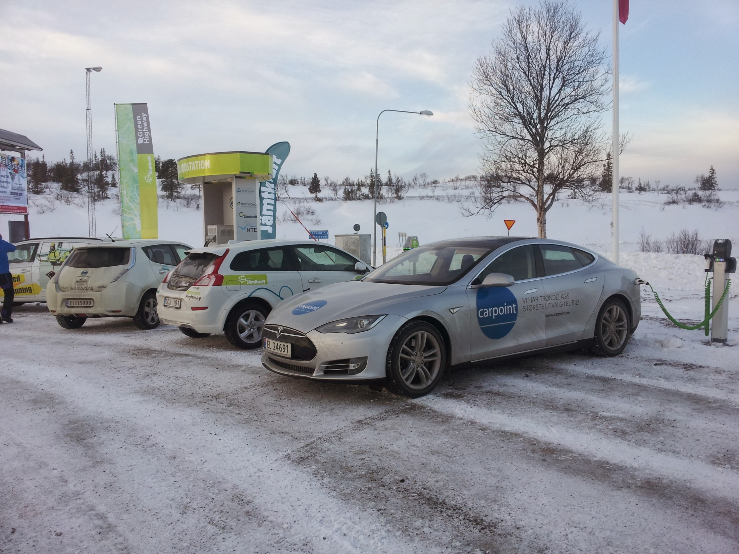
mikael.hagman@jamtkraft.se
Notes:
Storlien the border between Sweden and Norway…

